Slide 1
Android Attendance System App
Name: Ayush Garg, Lakshay
Roll no:2K19CSUN01015, 2K19CSUN01033
B-Tech CSE 5C
https://github.com/doit228/MC-PROECT/

Slide 2
INTRODUCTION
The mobile attendance system has been built to eliminate the time and effort wasted in taking attendances in schools and colleges. It also greatly reduces the amount of paper resources needed in attendance data management. This is an android mobile app. It’s built to be used for school/college faculty so that they may take student attendance on their phones.

Slide 3
The system is divided in following module:
Student Attendance List Creation: Once this App is installed on a phone, it allows user to create a student attendance sheet consisting of name, roll number, date, Absent/Present mark and subject. He has to fill student names along with associated roll numbers.
Attendance Marking: The faculty has the list on his phone now. He may see the list call roll numbers and select absent id the student is absent or select present if student is present.
Attendance Storage: This data is now stored in the faculty mobile phone. Faculty may also view it anytime on their phone.
Attendance sheet transfer: The faculty can transfer the file to a server (normal computer) via a Bluetooth connection where this data can be stored and maintained by the school or college.

Slide 4
ADVANTAGES:
The system eliminates the use of paperwork needed for attendance marking and monitoring.
The file can be transferred from mobile to computer or server via Bluetooth.
This gives the overall performance of class in attendance.
There is no need for laptop or computer in every class to run the system as the system is run on mobile so no need of extra efforts and resources.
The app is easy to install and use.

Slide 5
Disadvantages
The system can be run on android platform only. Though most of the mobiles now are android version and available in reasonable rate so it won’t be a big issue.

Slide 6
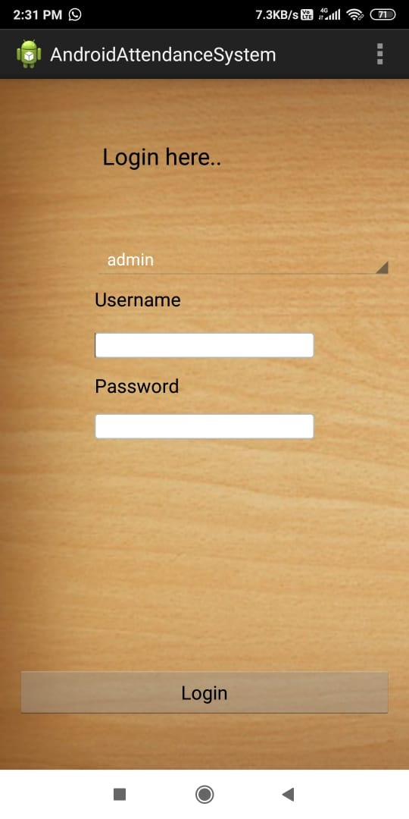
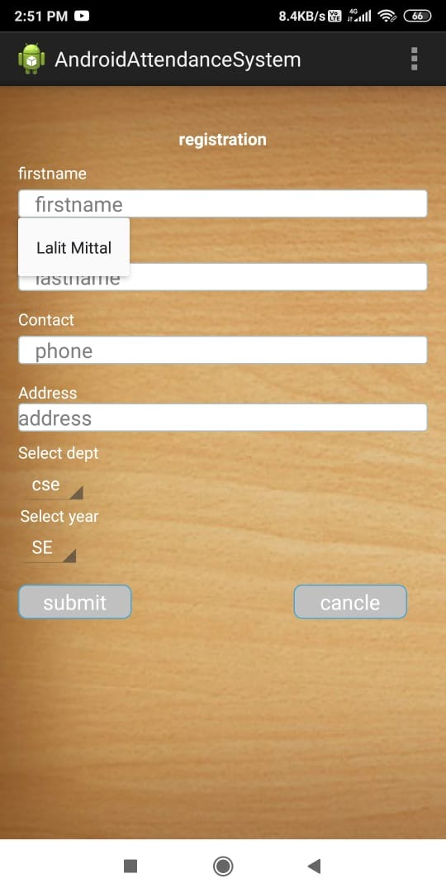
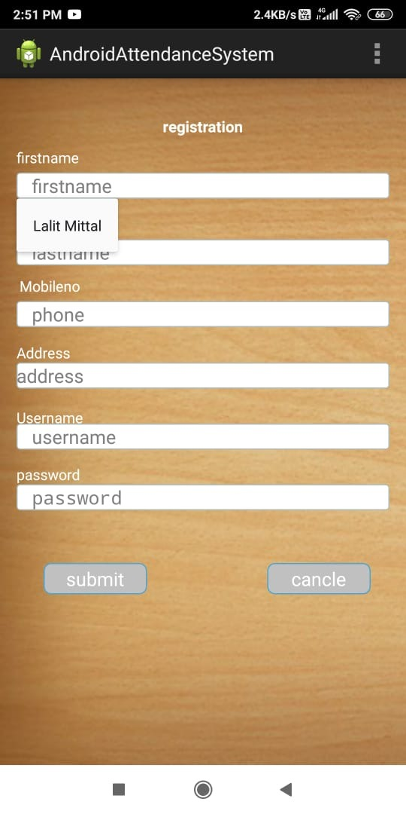
LOGIN PAGE ADMIN:
IN LOGIN ADMIN PAGE WE CAN ADD FACULTY AND ADD STUDENT

Slide 7
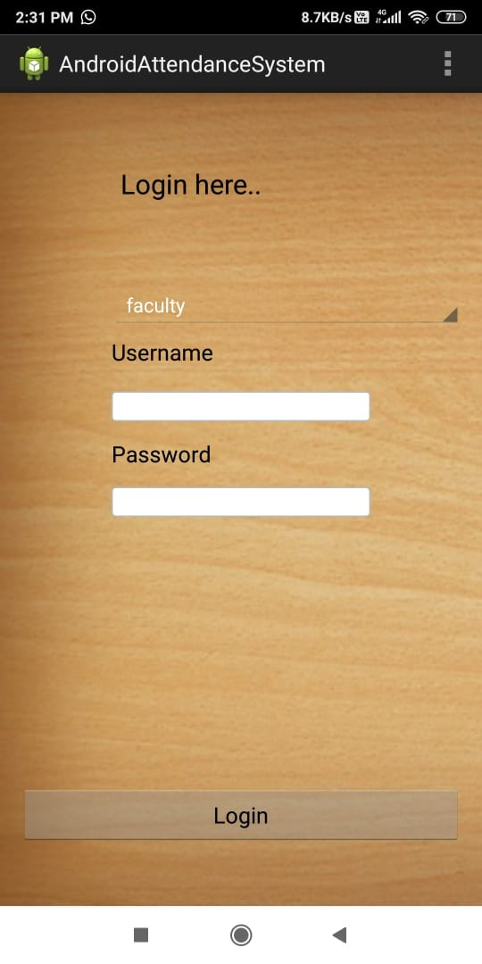
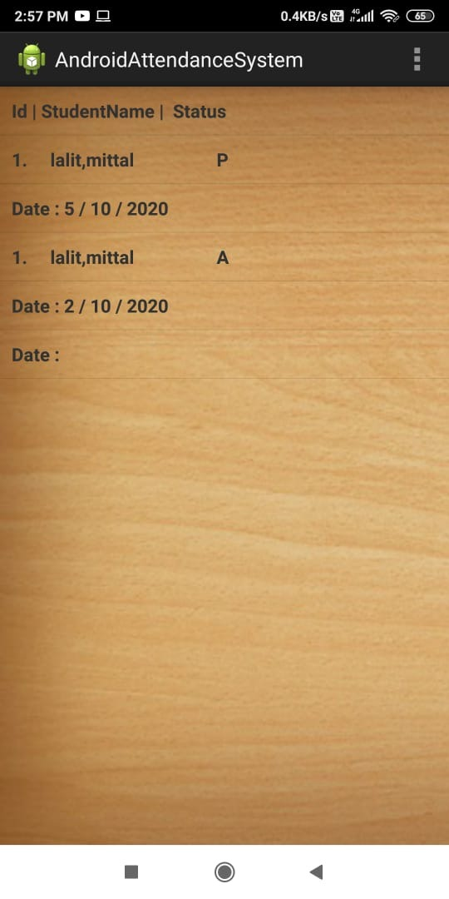
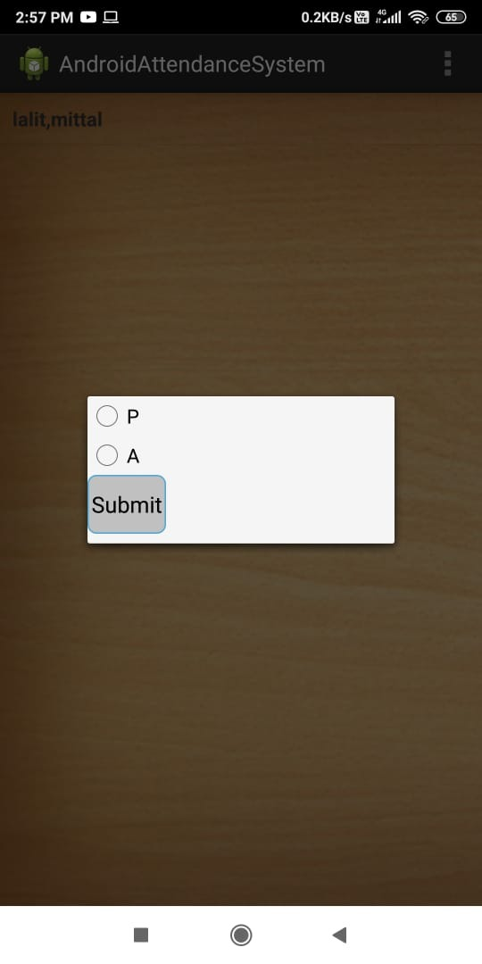
FACULTY LOGIN PAGE:
IN FACULTY LOGIN PAGE TEACHER CAN UPDATE ATTENDENCE ,VIEW ATTENDENCE (CALENDER WISE)

Slide 8
THANK YOU

